Slide 1

Department of Computer Science and Engineering
FAKE JOB RECRUITMENT DETECTION
Date: 22 April 2021
K. Susritha : 17WH1A0554
M.Priyanka : 17WH1A0505
M.Deepika : 17WH1A0511
Internal Guide : Ms. P. Kavitha Designation : Assistant Professor

Slide 2


Abstract
Why Should I Study this course?
Examples
BVRIT HYDERABAD College of Engineering for Women
Freshers are coming out from their education level to job experience level. In such process of finding their suitable jobs they are ending up in some fake jobs recruitment processes.
So, in order to find the fake recruitment, our project has come into existence. We are using machine learning approaches using classification techniques which are able to detect such fake recruitments.
Different classifiers are used for checking fraudulent posts in web and the results of those classifiers are compared for identifying the best employment scam detection model. It helps in finding the fake posts from enormous number of posts. We can use both the single classifier and ensemble classifier.

Slide 3
Dataset
Attribute | Description
Job_id | Unique Job ID
Title | The title of the job ad entry
Location | Geographical location of the job ad
Department | Corporate department
Salary_range | Indicative salary range
Company_profile | A brief company description.
Description | The details description of the job ad.
Requirements | Enlisted requirements for the job opening
benefits | Enlisted offered benefits by the employer.
.

Slide 4
Dataset
Why Should I Study this course?
Examples
BVRIT HYDERABAD College of Engineering for Women
Attribute | Description
telecommuting | True for telecommuting positions.
has_company_logo | True if company logo is present.
has_questions | True if screening questions are present.
employment_type | Full-type, Part-time, Contract, etc.
required_experience | Executive, Entry level, Intern, etc.
required_education | Doctorate, Master’s Degree, Bachelor, etc
industry | Automotive, IT, Health care, Real estate, etc.
function | Consulting, Engineering, Research, Sales etc.
fraudulent | target - Classification attribute.

Slide 5
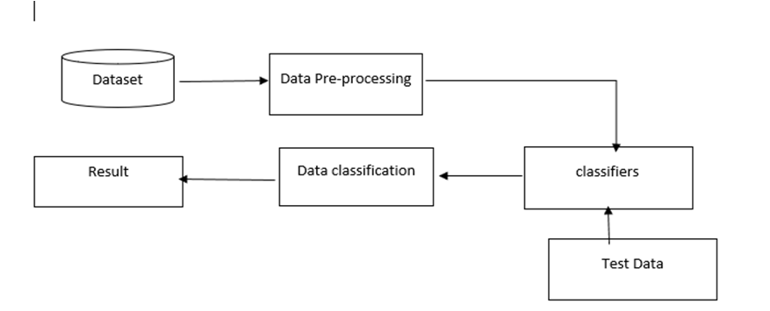
Architecture
Why Should I Study this course?
Examples
BVRIT HYDERABAD College of Engineering for Women

Slide 6

Technology Stack
Why Should I Study this course?
Examples
BVRIT HYDERABAD College of Engineering for Women
Machine learning
Python

Slide 7
System Requirements
Why Should I Study this course?
Examples
BVRIT HYDERABAD College of Engineering for Women
Environment | Speciﬁcations
Hardware | 1GB RAM 80GB Hard Disk Intel Processor
Software | Windows OS Python GUI or Anaconda Navigators OS: Windows 10

Slide 8
Timeline
Why Should I Study this course?
Examples
BVRIT HYDERABAD College of Engineering for Women
Review 0 | Requirements & Speciﬁcations
Review 1 | Data Collection
Review 2 | Data Pre-Processing Apply Algorithm
Review 3 | Evaluation

Slide 9
References
Why Should I Study this course?
Examples
BVRIT HYDERABAD College of Engineering for Women
https://www.researchgate.net/publication/341325717_Fake_Job_Recruitment_Detection_Using_Machine_Learning_Approach
https://www.kaggle.com/shivamb/real-or-fake-fake-jobposting-prediction
H. M and S. M.N, ―A Review on Evaluation Metrics for Data Classification Evaluations,‖ Int. J. Data Min. Knowl. Manag
B. Alghamdi and F. Alharby, ―An Intelligent Model for Online Recruitment Fraud Detection,” J. Inf. Secur., vol. 10
H. Sharma and S. Kumar, ―A Survey on Decision Tree Algorithms of Classification in Data Mining,‖ Int. J. Sci. Res

Slide 10
Thank you

